Slide 1
A Fuzzy Logic Based Approach for Enhancing Depth Perception in Computer Graphics
M.Sc. Thesis
by
Zeynep Çipiloğlu
Advisor: Asst. Prof. Dr. Tolga Çapın

Slide 2
OUTLINE
Overview
Background
Depth cues
Cue combination
Rendering methods
Approach
Results
Conclusion

Slide 3
Overview
Problem:
Better visualization of 3D
Extra work for content creators
Goal:
Challenges:
Which depth cues?
Which rendering methods?
2 domains: Human Visual Perception & Computer Graphics
Original 3D scene
Depth perception enhancement framework
Enhanced scene

Slide 4
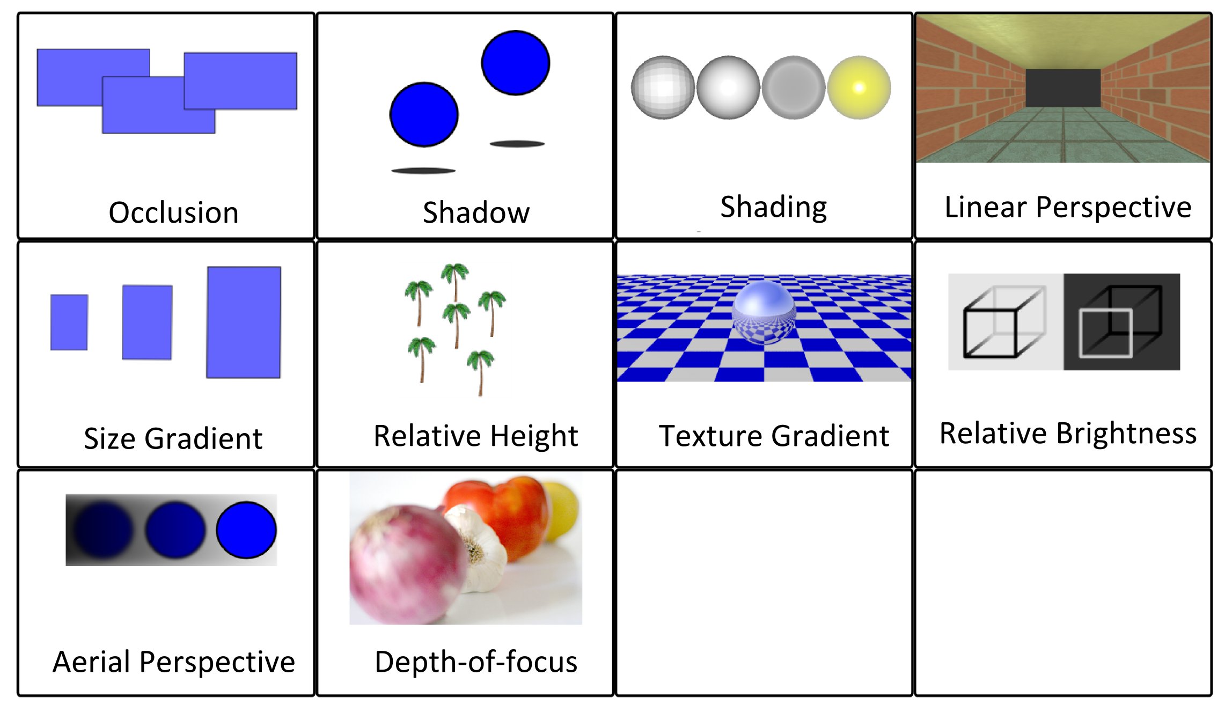
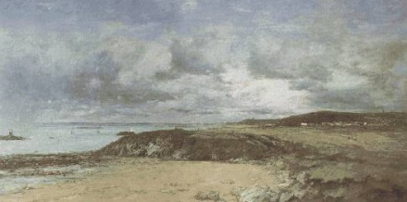
Background: Pictorial Depth Cues

Slide 5
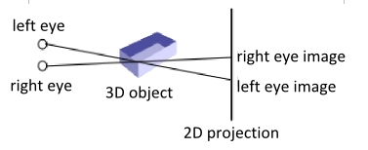
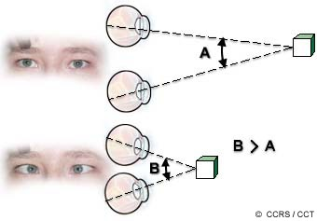
Background: Binocular and Occulomotor Depth Cues
Binocular Disparity:
2 eyes: from slightly different viewpoints
Occulomotor
Accommodation
The amount of distortion in the eye lens to fixate on an object
Convergence
The fixation of the eyes towards a single location to maintain binocular vision

Slide 6
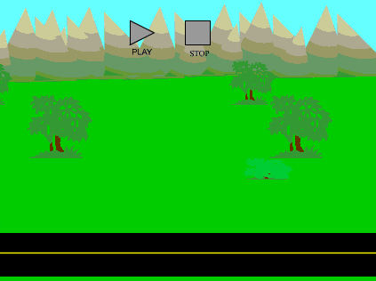
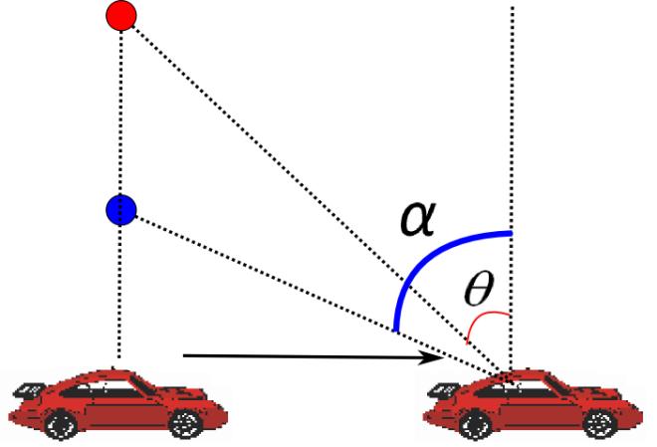
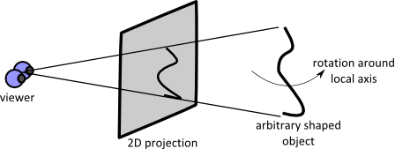
Background: Motion-based Depth Cues
Motion parallax
Closer objects move more in the visual field
Motion perspective
Similar to motion parallax
Viewer is stationary
Kinetic depth
Rotation around local axis
Shape perception

Slide 7
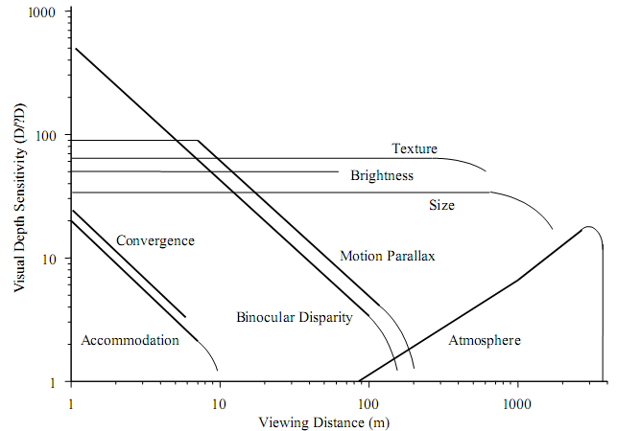
Background: Cue Combination
Questions:
How the human visual system unifies different depth cues?
How do the depth cues interact with each other?
What affects the strength of depth cues?
Combination models:
Cue averaging [Oruc03]
Cue dominance [Howard08]
Cue specialization [Ware04]
Range extension [Cutting95]

Slide 8
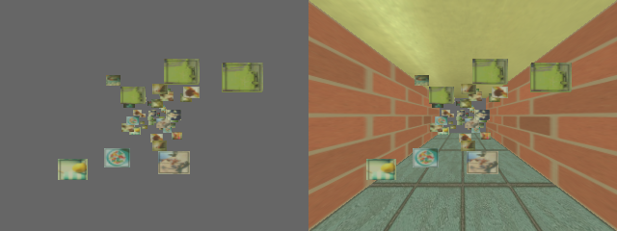
Background: Rendering Methods
Occlusion, size gradient, relative height
Matrix transformations [Swain09]
Perspective projection
Ground plane, room
Reference objects
Lines to ground
Relative brightness, aerial perspective
Fog
Proximity luminance [Ware04]
Gooch shading [Gooch98]

Slide 9
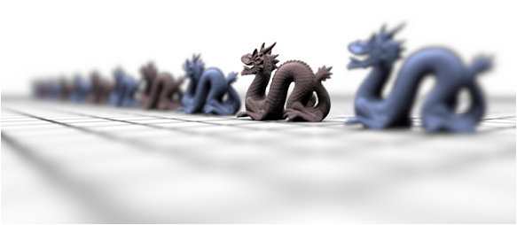
Background: Rendering Methods
Texture gradient
Bump mapping
Relief mapping [Oliveira00]
Depth-of-focus
Depth-of-field [Haeberli90]
Normal
Parallax
Relief

Slide 10
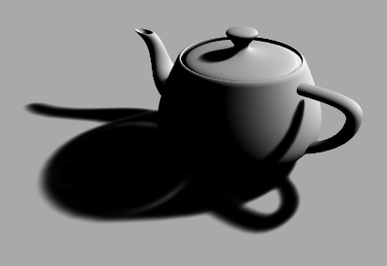
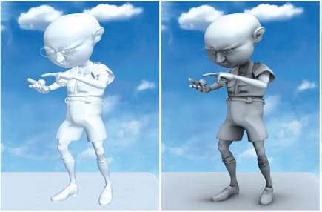
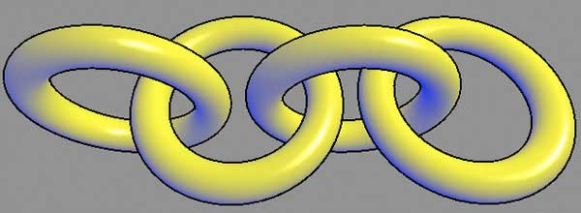
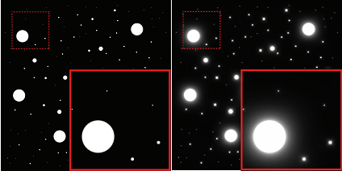
Background: Rendering Methods
Shading, shadow
Shadow map
Ambient Occlusion
[Bunnel04]
Gooch shading
[Gooch98]
Boundary Enhancement [Luft06, Nienhaus03]
Halo effect [Bruckner07]

Slide 11
Background: Rendering Methods
Motion related cues
Mouse/keyboard controlled motion
Face tracking [Bulbul10]
Magnetic trackers
Occulomotor and binocular cues
Multi-view rendering [Dodgson05, Halle05]
Parallax, lenticular, holographic
Anaglyph glasses, shutter glasses
HMDs

Slide 12
Background: Rendering Methods
Tarini et al.
Molecular visualization
Ambient occlusion
Edge cueing
Weiskopf and Ertl
Color transformations
Swain
Shading, brightness, occlusion, depth-of-focus
Background, foreground, object of interest
Current solutions are limited:
Domain specific
Not comprehensive

Slide 13
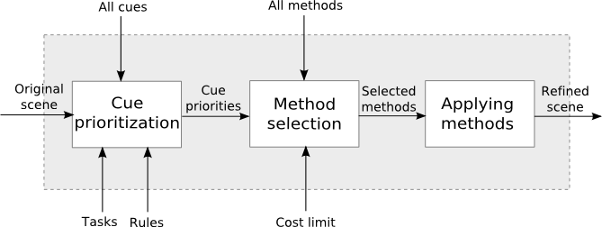
Approach
A system that enhances the depth perception of a given scene
Considers
User’s tasks, the spatial layout of the scene, costs of the methods
Hybrid system
Cue specialization
Range extension
Weighted linear combination

Slide 14
Stage 1: Cue Prioritization
Aim: Determining proper depth cues for the given scene
Input: Task, distance, and scene layout
Output: Cue priority values
Methodology: Fuzzy logic-based decision
Why fuzzy logic?
Terms are fuzzy (e.g: strong, weak, effective…)
Multi-input (task, scene layout, etc.)
Binary logic is not sufficient
Used to model the human control logic, perception [Brackstone00, Russel97]

Slide 15
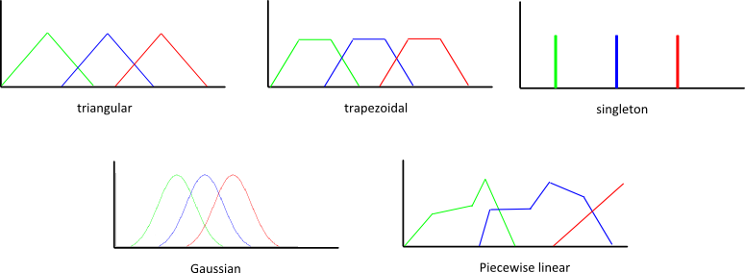
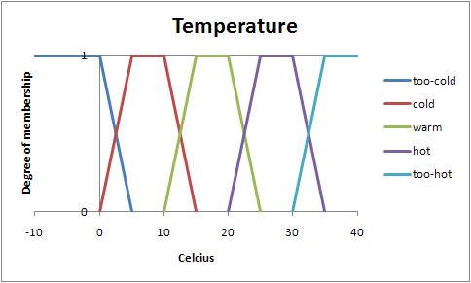
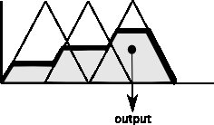
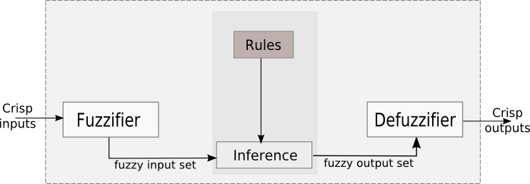
Fuzzy Logic
1. Fuzzification
3. Defuzzification
2. Inference

Slide 16
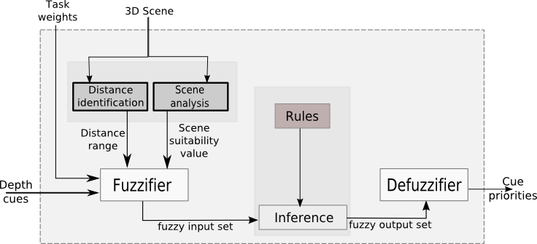
Cue Prioritization Architecture

Slide 17
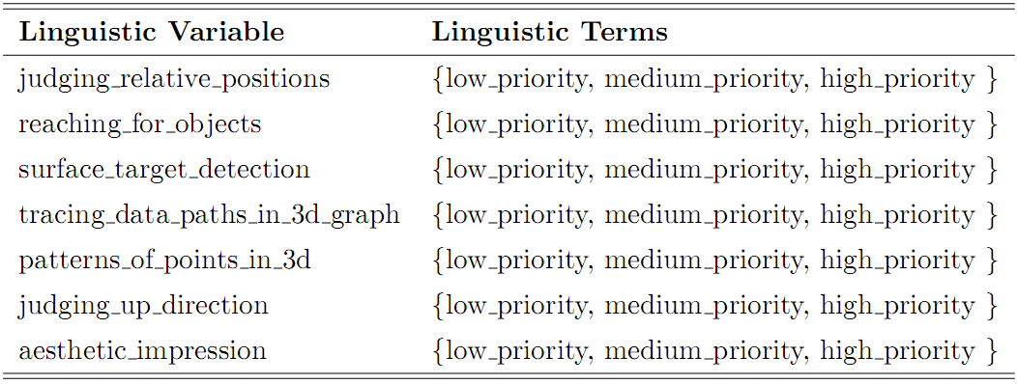
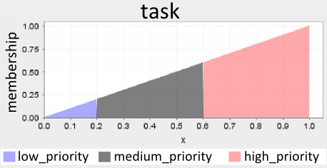
Cue Prioritization: Fuzzification
Task
Cue specialization
Classification by Ware [Ware04]
Membership func.

Slide 18
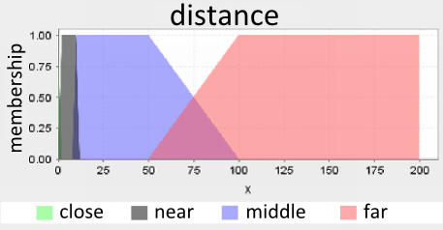
Cue Prioritization: Fuzzification
Distance
Range extension
Based on [Cutting95]
Membership func.

Slide 19
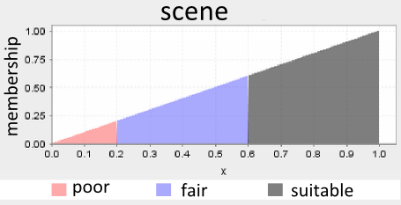
Cue Prioritization: Fuzzification
Scene layout
Cast shadows give the best results when the objects are slightly above the ground plane [Ware04]
Membership function

Slide 20
Cue Prioritization: Inference
Sample rules
IF scene is suitable AND (minDistance is close OR maxDistance is close) AND patterns_of_points_in_3d is high_priority THEN binocular_disparity is strong
IF scene is suitable AND maxDistance is far THEN aerial_perspective is strong
Fuzzy operators

Slide 21
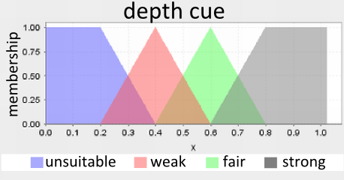
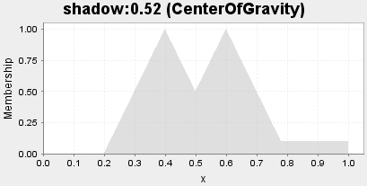
Cue Prioritization: Defuzzification
Membership function
Defuzzification algorithm: COG

Slide 23
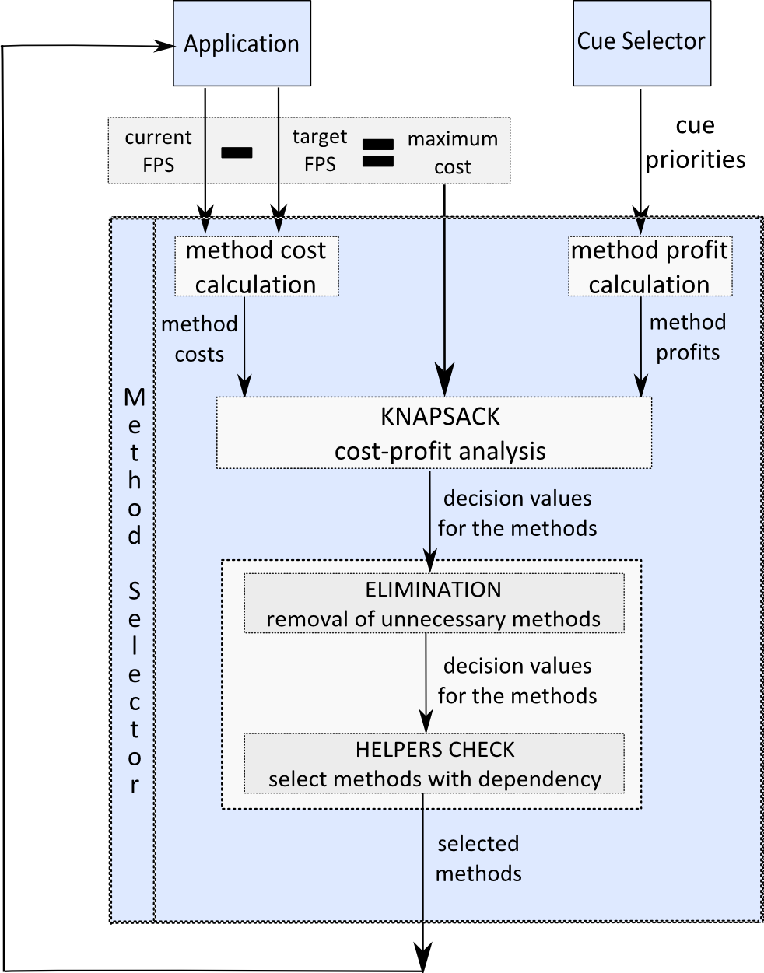
Stage 2: Method Selection
Aim:
Selecting the methods that provide the high priority cues, with minimum cost
Input:
Cue priority vector, method costs, cost limit
Output:
Selected methods list
Methodology:
Cost-profit analysis using Knapsack

Slide 24
Stage 2: Method Selection
Model: “budget allocation” using Knapsack problem
M: the set of all depth enhancement methods
Profit_{i} : the profit of method i
Cost_{i} : the cost of method i (in terms of frame rate)
maxCost: budget limit
x_{i} : solution {0, 1}
Dynamic programming
Weighted linear combination

Slide 25
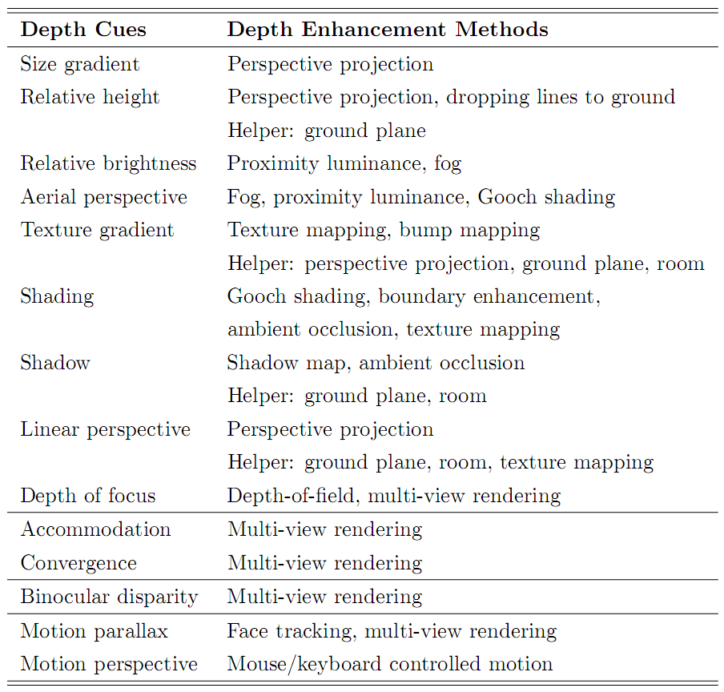
Stage 2: Method Selection
Elimination
Same purpose methods
Mutually-exclusive
Helpers check
Dependency
Multi-pass
Estimated FPS ~= target FPS
Actual FPS < target FPS

Slide 27
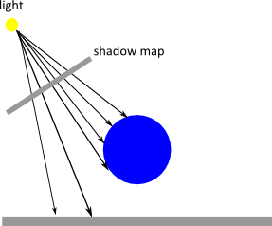
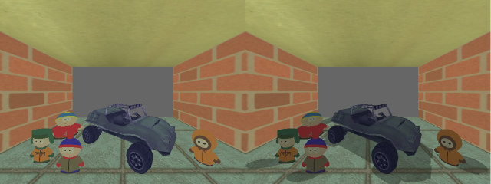
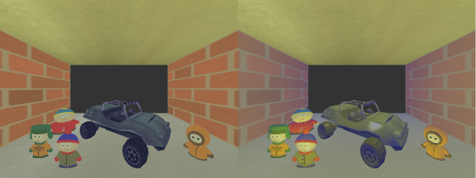
Stage 3: Rendering Methods
Shadow map
Shadow
Gooch shading
Shading
Aerial perspective

Slide 28
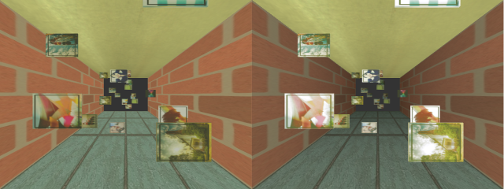
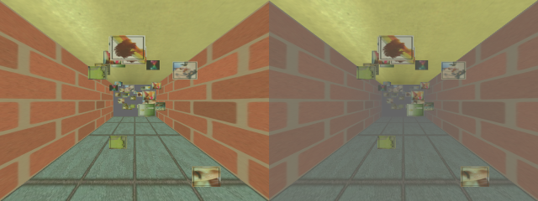
Stage 3: Rendering Methods
Proximity luminance
Relative brightness
Aerial perspective
Fog
Aerial perspective
Relative brightness

Slide 29
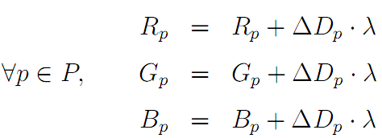
Stage 3: Rendering Methods
Boundary enhancement
Shading
Luft et al.’s method [Luft06]

Slide 30
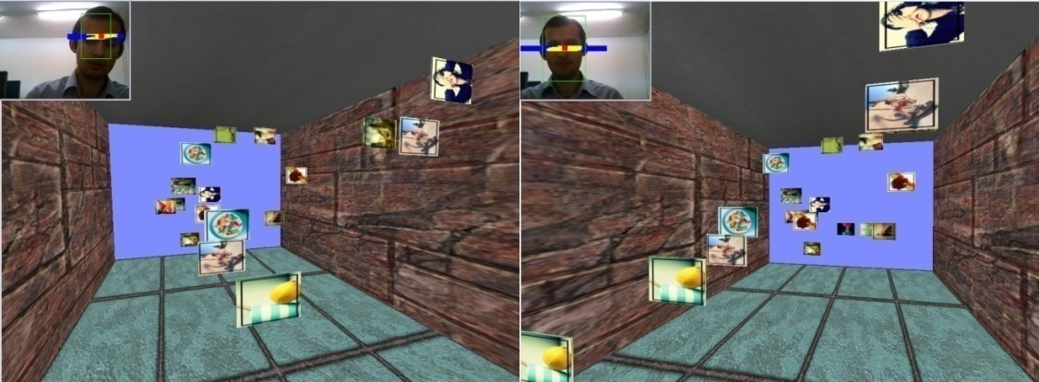
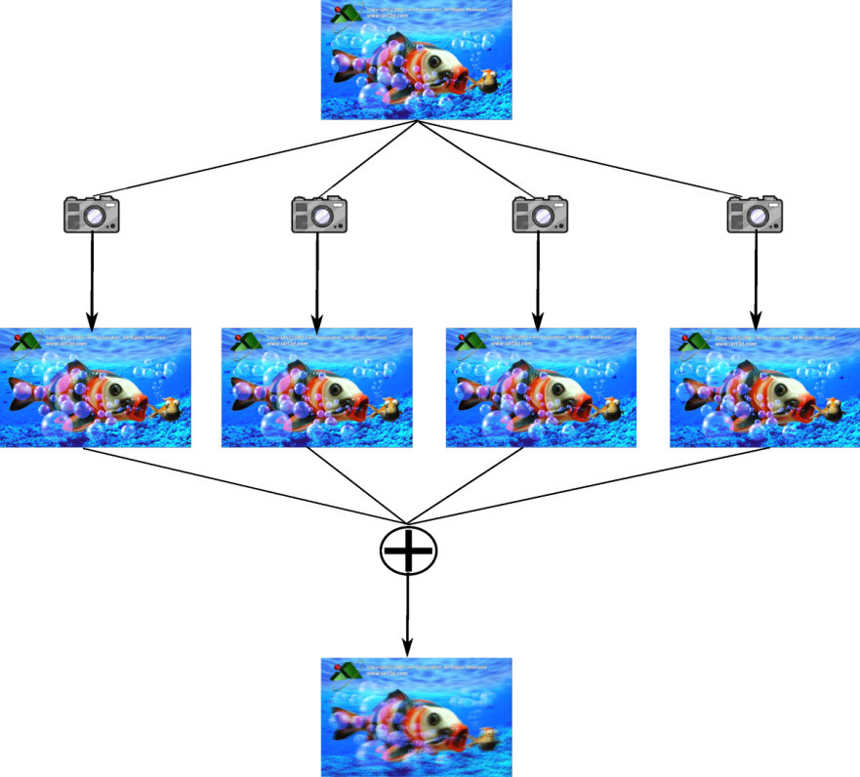
Stage 3: Rendering Methods
Face tracking
Motion parallax
Bulbul et al.’s method [Bulbul10]
Multi-view rendering
Binocular disparity
Accommodation, convergence
Depth-of-focus
9-view lenticular

Slide 31
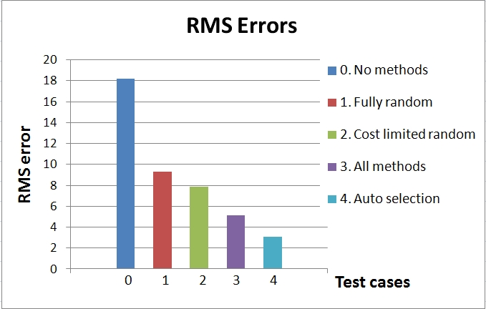
Experimental Results: Objective
Main task: Judging relative positions
Procedure: Estimate the z value of the given ball
5 techniques for selecting depth enhancement methods were compared.
Proposed algorithm (auto selection) is the best with 3.1% RMS error.

Slide 32
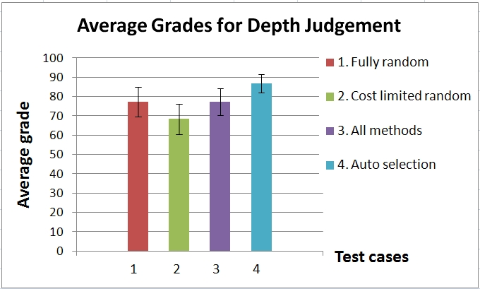
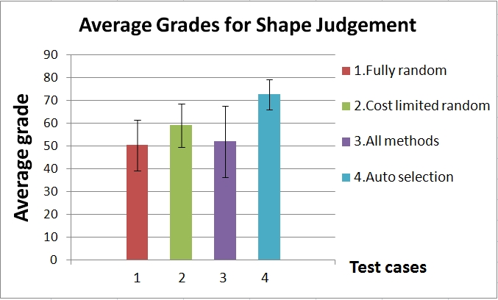
Experimental Results: Subjective
Main task:
Judging relative positions
Surface target detection (shape perception)
Procedure: Grade the given scene between 0-100
Proposed method’s grade: ~87 (task 1), ~73 (task 2)
Statistically significant difference is shown by t-test.

Slide 33
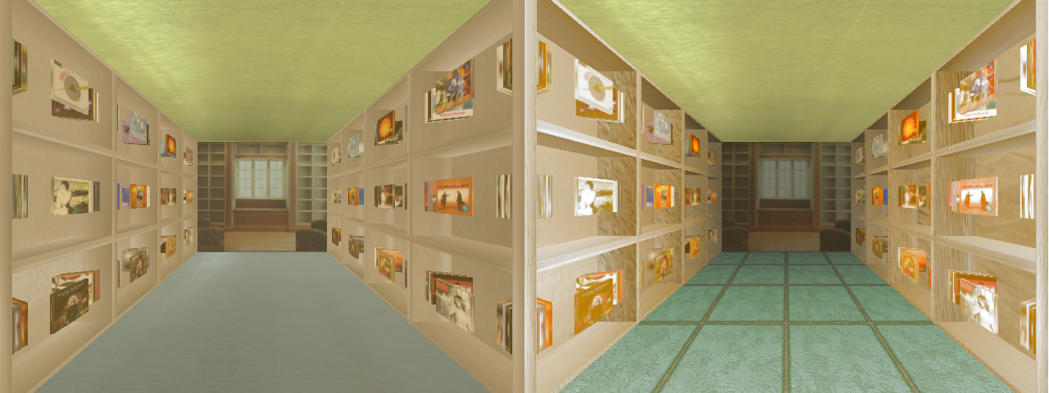
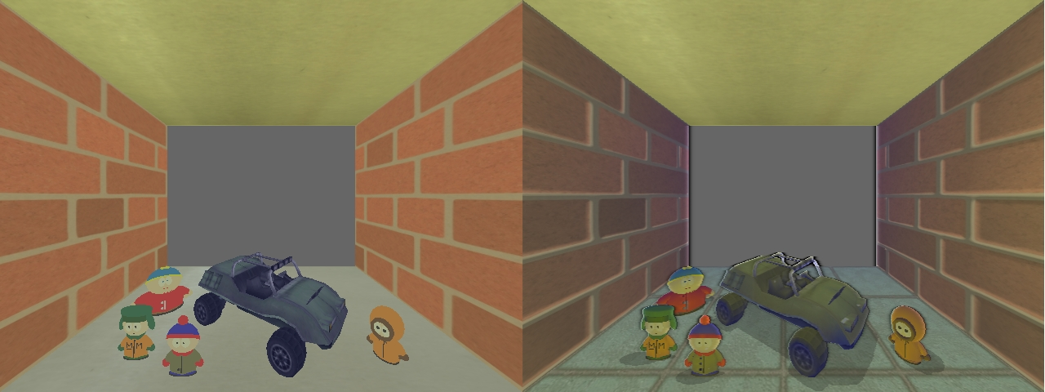

Slide 34
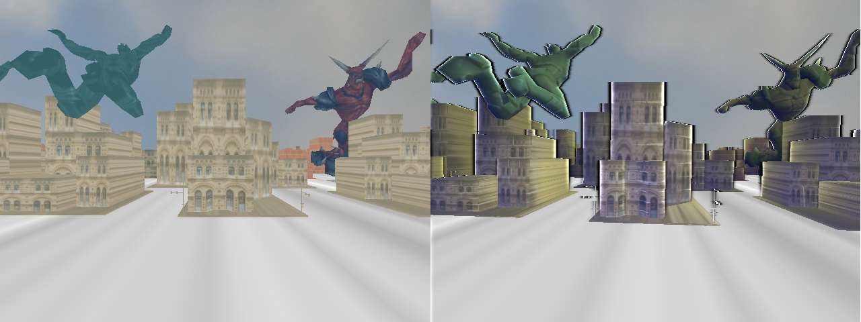
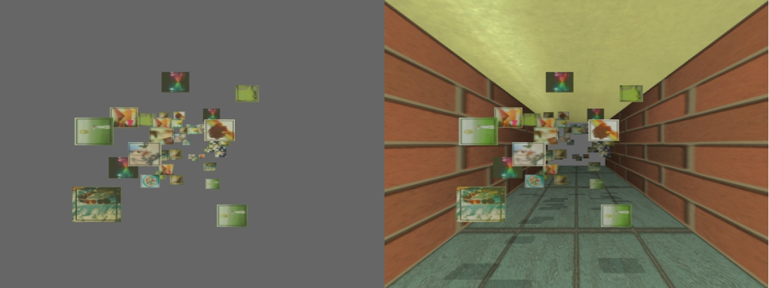

Slide 35
Conclusion
A framework for enhancing depth perception of a given scene
A fuzzy logic based algorithm for automatically determining the proper depth cues
A knapsack model for selecting proper depth enhancement methods
A formal experimental study
Future work
More tests
Improve the rule base
Add new rendering methods
Effects of animation
Different multi-view technologies
Demo

Slide 36
THANKS FOR YOUR ATTENTION ANY QUESTIONS?

Slide 37
References
[Cutting95] Cutting J, Vishton P. Perceiving Layout and Knowing Distance: The Integration, Relative Potency and Contextual use of Different Information about Depth. Perception of Space and Motion. New York: Academic Press; 1995.
[Ware04] Ware C. Space Perception and the Display of Data in Space. Information Visualization: Perception for Design: Morgan Kauffman; 2004.
[Howard08] Howard IP, Rogers BJ. Seeing in Depth. Toronto; 2008.
[Bunnell04] Bunnell M. Dynamic Ambient Occlusion and Indirect Lighting. GPU Gems 2: Addison- Wesley; 2004.
[Luft06] Luft T, Colditz C, Deussen O. Image enhancement by unsharp masking the depth buffer. ACM Transactions on Graphics (TOG). 2006; 25(3).
[Nienhaus05] Nienhaus M, Dollner J. Blueprint Rendering and "Sketchy Drawings“. GPU Gems 2. New Jersey: Addison Wesley; 2005.
[Gooch98] Gooch A, Gooch B, Shirley P, Cohen E. A Non-photorealistic Lighting Model for Automatic Technical Illustration. Paper presented at: Proceedings of the 25th Annual Conference on Computer Graphics and Interactive Techniques , 1998.
[Bruckner07]Bruckner S, Gröller E. Enhancing Depth-Perception with Flexible Volumetric Halos. IEEE Transactions on Visualization and Computer Graphics. 2007; 13(6): 1344-1351.

Slide 38
References
[Bülthoff96] Bülthoff HH, Yuille A. A Bayesian framework for the integration of visual modules. Attention and Performance: Information Integration in Perception and Communication. 1996; XVI: 49-70.
[Pfautz00] Pfautz J. Depth Perception in Computer Graphics: Cambridge University; 2000.
[Brackstone00] M. Brackstone. Examination of the use of fuzzy sets to describe relative speed perception. Ergonomics, 43(4):528-542, 2000.
[Bulbul10] A. Bulbul, Z. Cipiloglu, and T. Capin. A color-based face tracking algorithm for enhancing interaction with mobile devices. The Visual Computer, 26(5):311-323, 2010.
[Dodgson05] N. A. Dodgson. Autostereoscopic 3d displays. Computer, 38:31-36, 2005.
[Haeberli90] P. Haeberli and K. Akeley. The accumulation buffer: Hardware support for high-quality rendering. SIGGRAPH Comput. Graph., 24(4):309-318, 1990.
[Halle05] M. Halle. Autostereoscopic displays and computer graphics. In SIGGRAPH'05: ACM SIGGRAPH 2005 Courses, page104, NewYork, NY, USA, 2005. ACM.
[Oliveira00] M. M. Oliveira. Relief Texture Mapping. PhD thesis, University of North Carolina, 2000.
[Swain09] C. T. Swain. Integration of monocular cues to improve depth perception, 2009.

