Slide 1
Hashing
Using balanced search trees (2-3, 2-3-4, red-black, and AVL trees), we can implement table operations (retrieval, insertion, and deletion) efficiently, in O(logN) time.
Can we find a data structure so that we can perform these table operations even faster (e.g., in O(1) time)?
→ HASH TABLES
In hash tables, we have
  An array (index ranges 0 … n – 1) and
    Each array location is called a bucket
  An address calculator (hash function), which maps a search key into an array index between 0 … n – 1

Slide 2
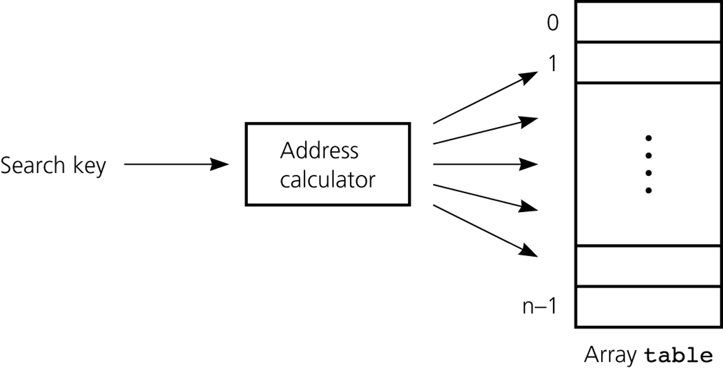
Hash Function -- Address Calculator
Hash Function
Hash Table

Slide 3
Hashing
A hash function tells us where to place an item in array called a hash table.
  This method is known as hashing.
A hash function maps a search key into an integer between 0 and n – 1.
  We can have different hash functions.
  The hash function is designed for the search keys depending on their (int, string, ...)
    E.g., h(x) = x mod n, where x is an integer

Slide 4
Collisions
A perfect hash function maps each search key into a unique location of the hash table.
  A perfect hash function is possible if we know all search keys in advance.
  In practice (we do not know all search keys), and thus, a hash function can map more than one key into the same location.
Collisions occur when a hash function maps more than one item into the same array location.
  We have to resolve the collisions using a certain mechanism.

Slide 5
Hash Functions
We can design different hash functions.
But a good hash function should
  be easy and fast to compute
  place items uniformly (evenly) throughout the hash table.
We will consider only hash functions that operate on integers.
  Since on a computer, everything is represented with bits and they can be converted into integers.
    1001010101001010000110…. remember?

Slide 6
Everything is an Integer
Even if our search keys are strings, we can think of them as integers, and apply a hash function which is designed to operate on integers to this integer value.
For example, strings can be encoded using ASCII codes of characters. Consider the string “NOTE”
  The ASCII code of N is 4Eh (01001110), O is 4Fh (01001111), T is 54h(01010100), E is 45h (01000101)
  Concatenate four binary numbers to get a new binary number
  01001110010011110101010001000101 = 4E4F5445h = 1313821765
  Apply 1313821765 mod tableSize

Slide 7
Hash Functions -- Selecting Digits
If the search keys are big integers, we can select certain digits and combine to create the address.
For example, suppose that we have nine-digit numbers
  Define a hash function that selects the 2nd and 5th most significant digits
  h(033475678) = 37
  h(023455678) = 25
  Define the table size as 100

Slide 8
Hash Functions -- Folding
We can select all digits and add them.
For example, suppose the previous nine-digit numbers
  Define a hash function that selects all digits and adds them
  h(033475678) = 0 + 3 + 3 + 4 + 7 + 5 + 6 + 7 + 8 = 43
  h(023455678) = 0 + 2 + 3 + 4 + 5 + 5 + 6 + 7 + 8 = 40
  Define the table size as 82
We can select a group of digits and add the digits in this group as well.

Slide 9
Hash Functions -- Modular Arithmetic
Modular arithmetic provides a simple and effective hash function.
h(x) = x mod tableSize
The table size should be a prime number.
  Why? Think about it.
We will use modular arithmetic as our hash function in the rest of our discussions.

Slide 10
Why Primes?
Assume you hash the following with x mod 8:
  64, 100, 128, 200, 300, 400, 500
0
1
2
3
4
5
6
7
64
128
200
400
100
300
500

Slide 11
Why Primes?
Now try it with x mod 7
  64, 100, 128, 200, 300, 400, 500
0
1
2
3
4
5
6
64
128
400
100
500
200
300

Slide 12
Rationale
If we are adding numbers a₁, a₂, a₃ … a₄ to a table of size m
  All values will be hashed into multiples of
  gcd(a₁, a₂, a₃ … a₄ ,m)
  For example, if we are adding 64, 100, 128, 200, 300, 400, 500 to a table of size 8, all values will be hashed to 0 or 4
  gcd(64,100,128,200,300,400,500, 8) = 4
  When m is a prime gcd(a₁, a₂, a₃ … a₄ ,m) = 1, all values will be hashed to anywhere
  gcd(64,100,128,200,300,400,500, 7) = 1
  unless gcd(a₁, a₂, a₃ … a₄ ) = m, which is rare.

Slide 13
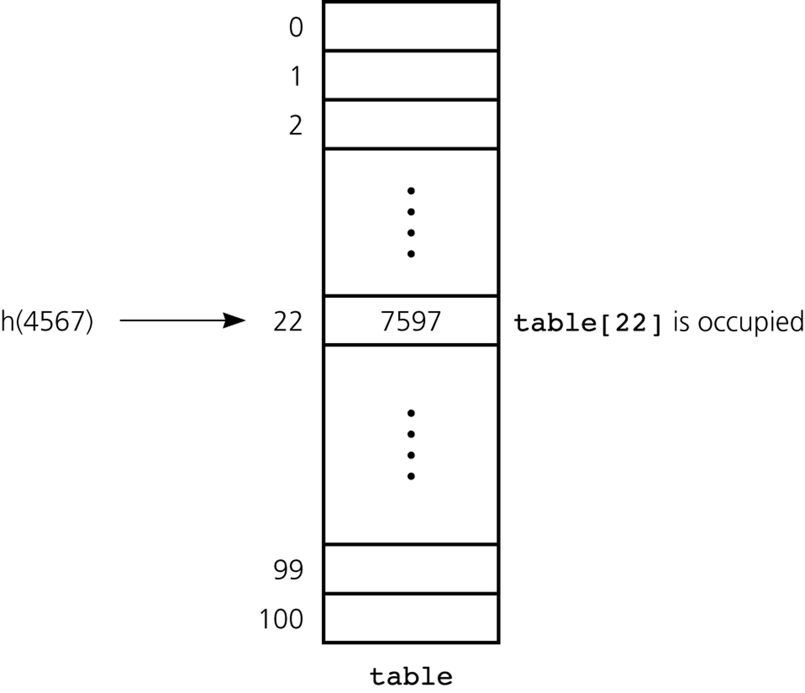
Collision Resolution
There are two general approaches to collision resolution in hash tables:
  Open Addressing
  Each entry holds one item
  Chaining
  Each entry can hold more than item
  (Buckets – hold certain number of items)
Table size is 101

Slide 14
Open Addressing
A hash table is said to use open addressing if it probes for some other empty location when a collision occurs.
  The sequence of locations that it examines is called the probe sequence.
There are different open-addressing schemes:
  Linear Probing
  Quadratic Probing
  Double Hashing

Slide 15
Open Addressing -- Linear Probing
In linear probing, we search the hash table sequentially starting from the original hash location.
  We check the next location if a location is occupied.
  We wrap around from the last table location to the first table location if necessary.

Slide 16
Linear Probing -- Example
Example:
  Table Size is 11 (0..10)
  Hash Function: h(x) = x mod 11
  Insert keys: 20, 30, 2, 13, 25, 24, 10, 9
    20 mod 11 = 9
    30 mod 11 = 8
    2 mod 11 = 2
    13 mod 11 = 2 ➔ 2+1=3
    25 mod 11 = 3 ➔ 3+1=4
    24 mod 11 = 2 ➔ 2+1, 2+2, 2+3=5
    10 mod 11 = 10
    9 mod 11 = 9 ➔ 9+1, 9+2 mod 11 =0
0 | 9
1
2 | 2
3 | 13
4 | 25
5 | 24
6
7
8 | 30
9 | 20
10 | 10

Slide 17
Linear Probing -- Clustering Problem
One of the problems with linear probing is that table items tend to cluster together in the hash table.
  This means that the table contains groups of consecutively occupied locations.
This phenomenon is called primary clustering.
  Clusters can get close to one another, and merge into a larger cluster.
  Thus, the one part of the table might be quite dense, even though another part has relatively few items.
  Primary clustering causes long probe searches, and therefore, decreases the overall efficiency.

Slide 18
Open Addressing -- Quadratic Probing
Primary clustering problem can almost be eliminated if we use a quadratic probing scheme.
In quadratic probing,
  We start from the original hash location i
  If a location is occupied, we check the locations i+1^{2 ,} i+2^{2 ,} i+3² , i+4² ...
  We wrap around from the last table location to the first table location, if necessary.

Slide 19
Quadratic Probing -- Example
Example:
  Table Size is 11 (0..10)
  Hash Function: h(x) = x mod 11
  Insert keys: 20, 30, 2, 13, 25, 24, 10, 9
    20 mod 11 = 9
    30 mod 11 = 8
    2 mod 11 = 2
    13 mod 11 = 2 ➔ 2+1²=3
    25 mod 11 = 3 ➔ 3+1²=4
    24 mod 11 = 2 ➔ 2+1², 2+2²=6
    10 mod 11 = 10
    9 mod 11 = 9 ➔ 9+1², 9+2² mod 11,
    9+3² mod 11 =7
0
1
2 | 2
3 | 13
4 | 25
5
6 | 24
7 | 9
8 | 30
9 | 20
10 | 10

Slide 20
Open Addressing -- Double Hashing
Double hashing also reduces clustering.
In linear and quadratic probing, increments used during probing are independent from the key.
Double hashing selects increments using a second hash function h₂. This second function should satisfy
h₂(key) ≠ 0
h₂ ≠ h₁
It probes the following locations until it finds an unoccupied place
h₁(key), h₁(key) + h₂(key), h₁(key) + 2*h₂(key), ...

Slide 21
Double Hashing -- Example
Example:
  Table Size is 11 (0..10)
  Hash Function: h₁(x) = x mod 11
  h₂(x) = 7 – (x mod 7)
  Insert keys: 58, 14, 91
    58 mod 11 = 3
    14 mod 11 = 3 ➔ 3+7=10
    91 mod 11 = 3 ➔ 3+7, 3+2*7 mod 11=6
0
1
2
3 | 58
4
5
6 | 91
7
8
9
10 | 14

Slide 22
Open Addressing -- Retrieval & Deletion
To retrieve an item with a given key, we probe the locations (same as insertion) until we find the desired item or we reach to an empty location.
Deletions in open addressing cause complications
  We CANNOT simply delete an item from the hash table because this new empty (a deleted) location causes to stop prematurely (incorrectly) indicating a failure during a retrieval.
  Solution: We have to have three kinds of locations in a hash table: Occupied, Empty, Deleted.
  A deleted location will be treated as an occupied location during retrieval and insertion.

Slide 23
Separate Chaining
Another way to resolve collisions is to change the structure of the hash table.
  In open-addressing, each location holds only one item.
  We can define a hash table so that each location is itself an array called bucket, so that we can store the items that are hashed into this location in this array.
    Problem: What will be the size of the bucket?
  A better approach is to design the hash table as an array of linked lists, this method is known as separate-chaining.
  In separate-chaining, each entry (of the hash table) is a pointer to a linked list (the chain) of the items that the hash function has mapped into that location.

Slide 24
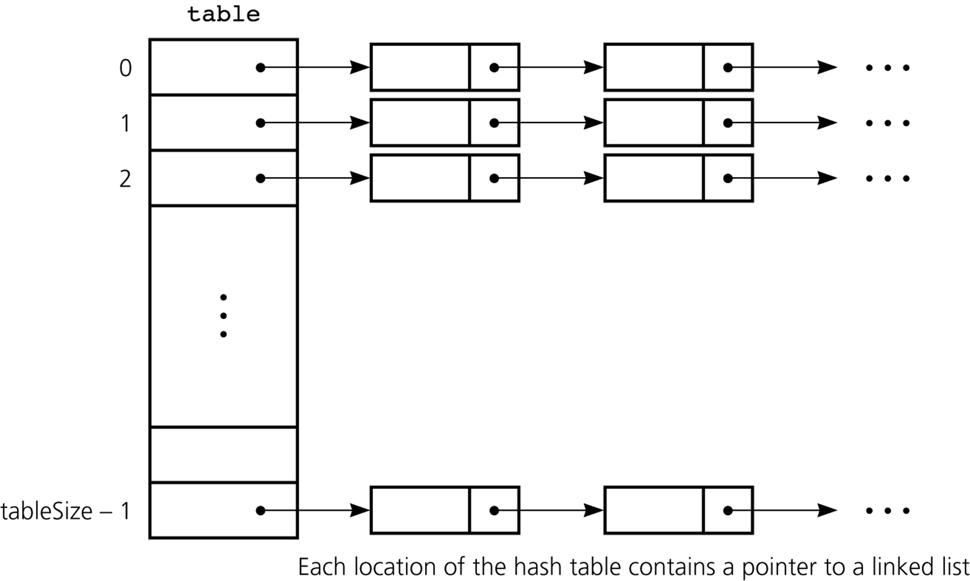
Separate Chaining

Slide 25
Hashing -- Analysis
An analysis of the average-case efficiency of hashing involves the load factor α
  The load factor is the ratio of the current number of items in the table to the table size.
  α = (current number of items) / tableSize
  The load factor measures how full a hash table is.
  The hash table should not be too loaded if we want to get better performance from hashing.
In average case analyses, we assume that the hash function uniformly distributes keys in the hash table.
Unsuccessful searches generally require more time than successful searches.

Slide 26
Separate Chaining -- Analysis
The approximate average number of comparisons (probes) that a search requires is given as follows:
for a successful search
for an unsuccessful search
It is the most efficient collision resolution scheme.
But it requires more storage (needs storage for pointers).
It easily performs the deletion operation. Deletion is more difficult in open-addressing.

Slide 27
Linear Probing -- Analysis
The approximate average number of comparisons (probes) that a search requires is given as follows:
for a successful search
for an unsuccessful search
As the load factor increases, the number of collisions increases, causing increased search times.
To maintain efficiency, it is important to prevent the hash table from filling up.

Slide 28
Linear Probing -- Analysis
Example: Find the average number of probes for a successful
search and an unsuccessful search for this hash table? Use the
following hash function: h(x) = x mod 11
Successful Search: Try 20, 30, 2, 13, 25, 24, 10, 9
  20: 9 30: 8 2: 2 13: 2,3
  25: 3,4 24: 2,3,4,5 10:10 9: 9,10,0
  Avg. no of probes = (1+1+1+2+2+4+1+3)/8 = 1.9
Unsuccessful Search: Try 0, 1, 35, 3, 4, 5, 6, 7, 8, 9, 32
  0: 0,1 1:1 35: 2,3,4,5,6
  3: 3,4,5,6 4: 4,5,6 5: 5,6
  6: 6 7: 7 8: 8,9,10,0,1
  9: 9,10,0,1 32: 10,0,1
  Avg. no of probes = (2+1+5+4+3+2+1+1+5+4+3)/11 = 2.8
0 | 9
1
2 | 2
3 | 13
4 | 25
5 | 24
6
7
8 | 30
9 | 20
10 | 10

Slide 29
Quadratic Probing & Double Hashing -- Analysis
The approximate average number of comparisons (probes) that a search requires is given as follows:
for a successful search
for an unsuccessful search
On average, both methods require fewer comparisons than linear probing.

Slide 30
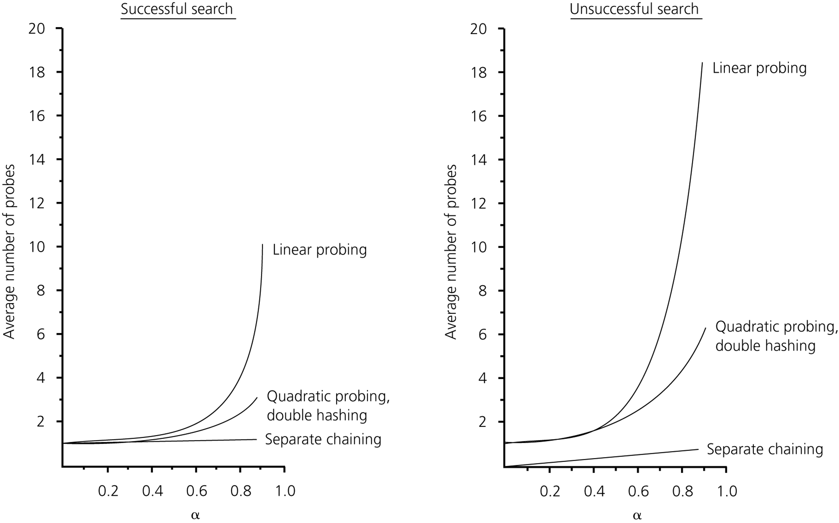
The relative efficiency of four collision-resolution methods

Slide 31
What Constitutes a Good Hash Function
A hash function should be easy and fast to compute.
A hash function should scatter the data evenly throughout the hash table.
  How well does the hash function scatter random data?
  How well does the hash function scatter non-random data?
Two general principles :
  The hash function should use entire key in the calculation.
  If a hash function uses modulo arithmetic, the table size should be prime.

Slide 32
Hash Table versus Search Trees
In most of the operations, the hash table performs better than search trees.
However, traversing the data in the hash table in a sorted order is very difficult.
  For similar operations, the hash table will not be good choice (e.g., finding all the items in a certain range).

